Slide 1
Generating Lyrics for Pop Songs using LSTM
Camille Bustalinio

Slide 2
Contents
Background
Steps
Results
Take-aways
If I had more time…

Slide 3
Background
In class:
Predicting next character trained on Alice in Wonderland
Andrej Karpathy used LSTMs to predict next char of different corpora
Rap song lyrics paper counted number of ending rhymes
Metal song lyrics had larger vocabulary
Pop songs have smaller vocabulary than rock songs, but use repetitions
Pop songs have more variable structure (inconsistent # of lines per stanze, variable # of syllables per line) unlike in rhyming rap

Slide 4
Steps
Gather Data
Max Martin wrote the most pop songs for the last 20 years (391)
Of 391 songs, 27 are for the Backstreet Boys
Data was in the form of a text file with multiple songs
“Song-break”: @@@@ > to predict end of song
Lyrics was from PyLyrics library
Convert Lyrics to Numbers
Generate mapping based on chars in corpus, then scale
X[0] : array([[ 0.61538462], [ 0.94871795], [ 0.76923077], [ 0.53846154], [ 0.38461538], [ 0.79487179], [ 0. ], [ 0.30769231], [ 0.30769231], [ 0.30769231], [ 0.30769231], [ 0. ], [ 0.07692308], [ 0.53846154], [ 0.02564103], [ 0.8974359 ], [ 0.33333333], [ 0.66666667], [ 0.66666667], [ 0.33333333], [ 0.02564103], [ 0.35897436], [ 0.43589744], [ 0.02564103], [ 0.8974359 ], [ 0.53846154], [ 0.82051282], [ 0.51282051], [ 0.02564103], [ 0.94871795]])
y[0]: array([ 0., 0., 0., 0., 0., 0., 0., 0., 0., 0., 0., 0., 0., 0., 0., 0., 0., 0., 0., 0., 0., 0., 0., 0., 0., 0., 0., 1., 0., 0., 0., 0., 0., 0., 0., 0., 0., 0., 0.]))

Slide 5
Steps
Train Models
Used layers: LSTMS, Dropouts, Dense
Used Adam optimizer, with different learning rates
Used Different Sequence Lengths
Used GPUs (g2.2xlarge & p2.16xlarge)
Generate lyrics
From a random seed (within Data)
Generate multiple samples
Generate text of different lengths (in character size)

Slide 6
Results
Demo…

Slide 7
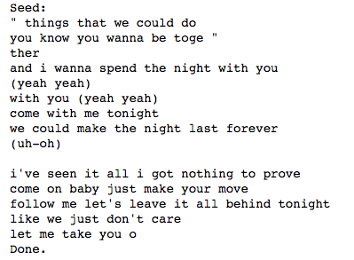
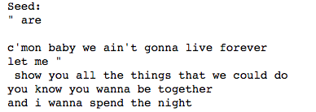
Results
Best in Prediction:

Slide 8
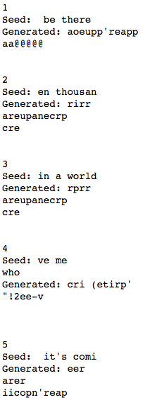
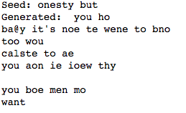
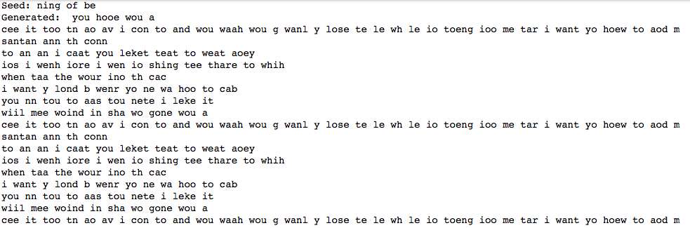
Results
With song form:

Slide 9
Take-Aways
LSTM models can be trained to generate text that include line-breaks that have the same form as song lyrics
Smaller sequence length results to shorter training time, and more repetitions in the song prediction
Longer sequence ➔ more words in training for next char, but LSTM forgets insignificant ones anyway…
Line repetition in pop songs stagnates training
When a model has training accuracy >0.9, it is able to predict the actual lyrics of the songs of which it has been trained
Saving model weights makes it easier to assess across models
LSTM lyrics generations uses at least 2000 epochs, using GPUs reduces training time from hundreds of hours
After 300 iterations, training breaks when running on local

Slide 10
If I had more time…
Run the model for weeks using P2 16 x-large AWS AMIs
Train on bigger data sets
Try removing repeated lines (these can be added during actual song-writing)
Compare lyrics generated from training using multiple composers for same artist, vs same composer for multiple artist, vs multiple composers for multiple artist
Using LSTM to generate MIDI

Slide 11
References
Andrej Karpathy: http://karpathy.github.io/2015/05/21/rnn-effectiveness/
Rap: http://www.emnlp2015.org/proceedings/EMNLP/pdf/EMNLP221.pdf
https://github.com/tonybeltramelli/Deep-Lyrics/blob/master/train.py

